Slide 1
C# Android Project

Slide 2
Google Play
8 Apps

Slide 3
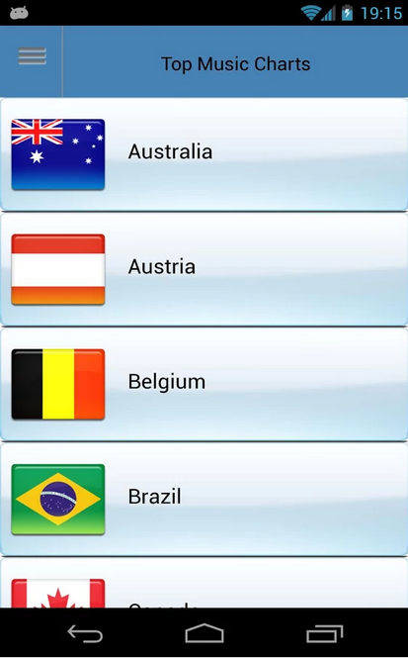
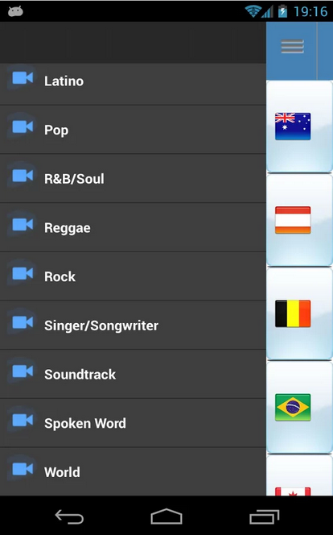
Top 100 Music Charts
Countries Genres
Review
Plays videos instead of songs

Slide 4
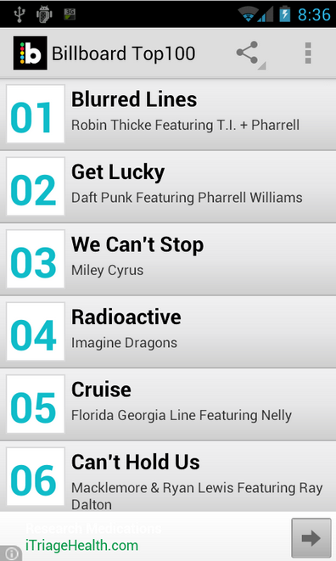
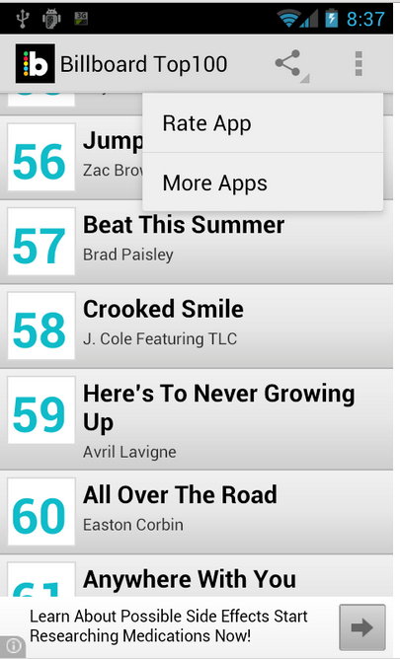
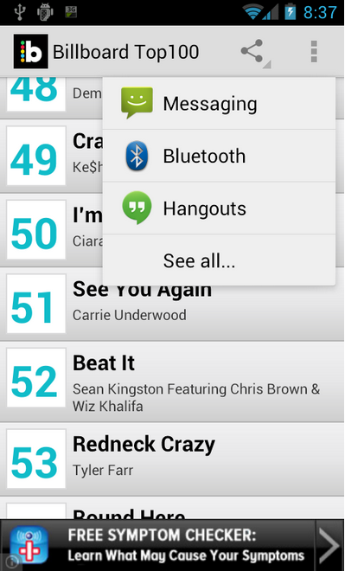
Billboard Top 100
Display Options
Send to
Review
Can’t sample the songs
Can’t search for a specific genre

Slide 5
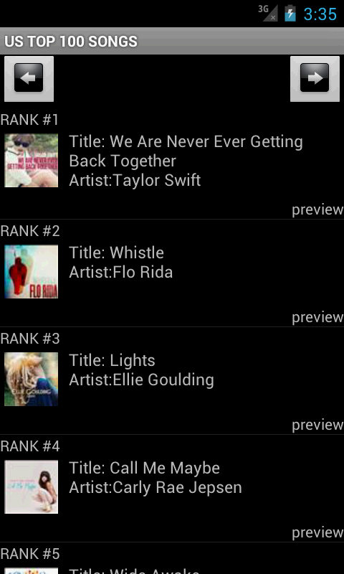
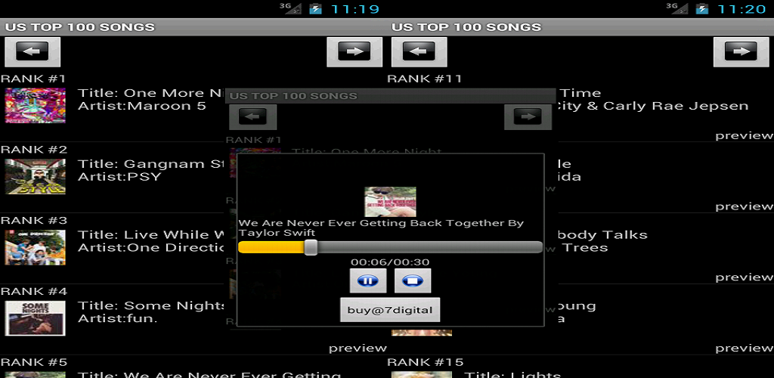
US Top 100 Songs
Landscape
Portrait
Review
Images are compressed and lose quality and proportions

Slide 6
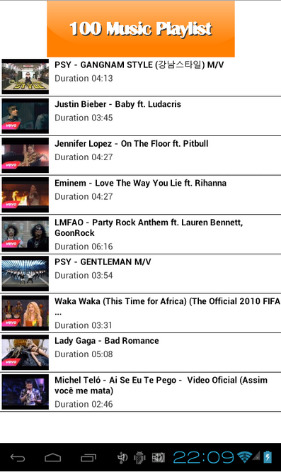


Top 100 Music Tube Playlist
Review
Youtube dependent

Slide 7
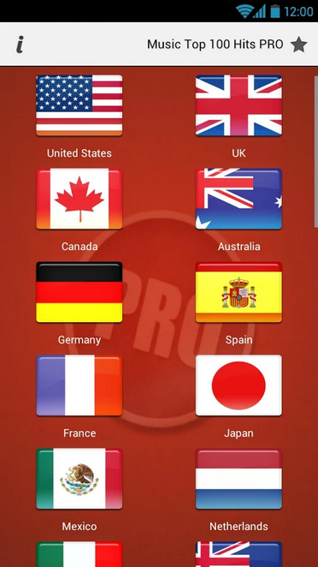
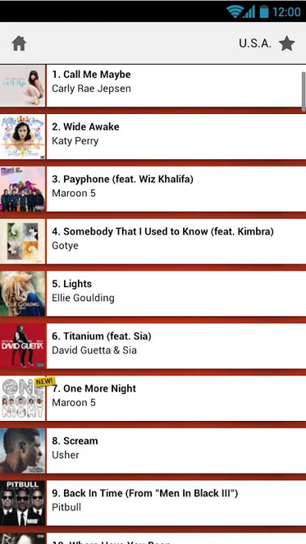
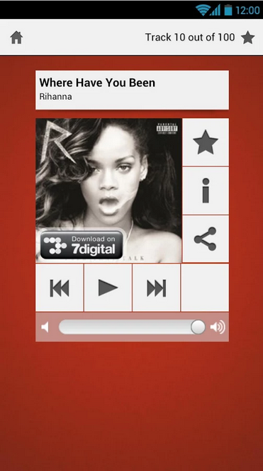
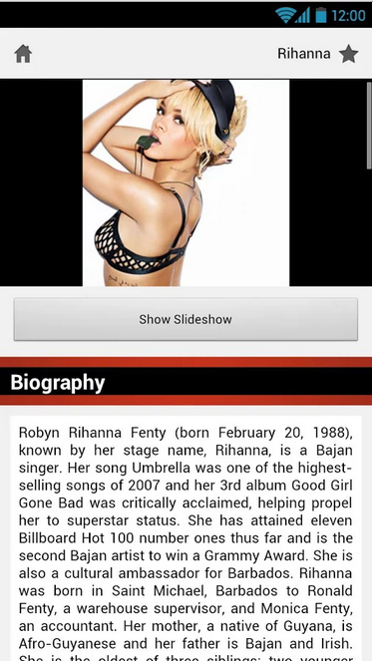
Music Top 100 Hits - PRO
Countries Chart Artist Bio
Review
1. iTunes Top 100 displays Top Music 3. Similar Artists can be displayed
2. Allows to share songs 4. Has a filter

Slide 8
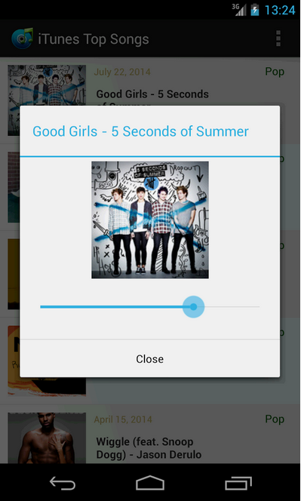
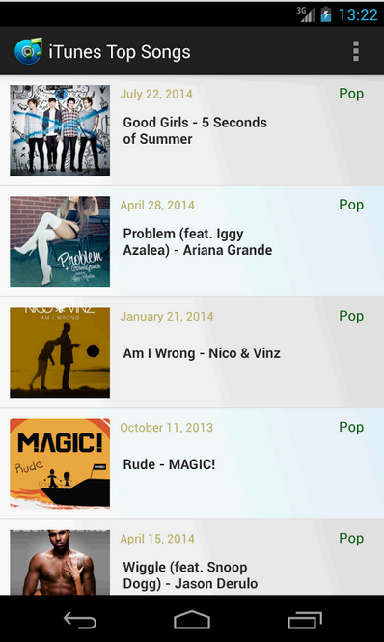
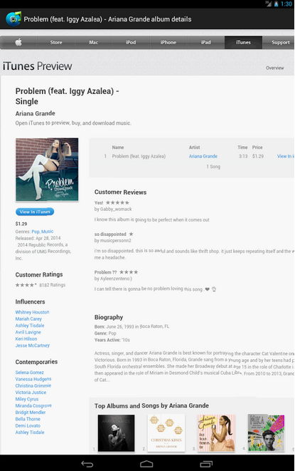
iTunes Top Song
Review
1. Can’t download any songs 2. Well received

Slide 9
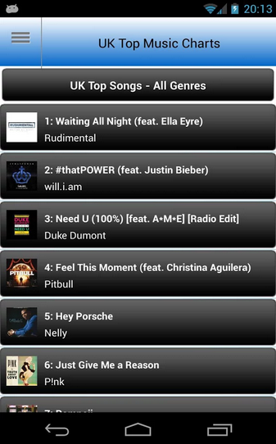
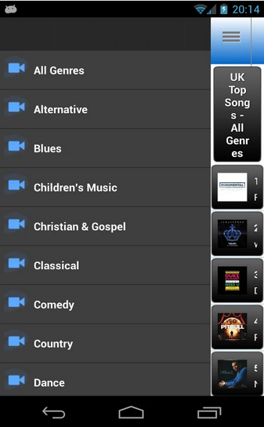
UK Top 100 Music Charts
Display Genres
Review
Play on:
Youtube
Spotify
Google Music
Rdio
2. Similar to US Top 100 Charts etc.

Slide 10
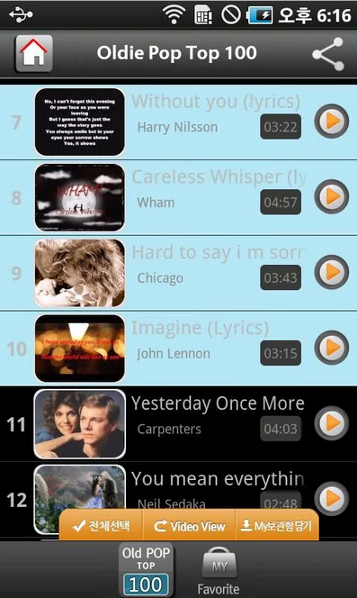
Oldie Pop Top 100
Review
Puts favourite songs in “My Favourites” etc.
Youtube videos

Slide 11
Apple
4 Apps

Slide 12
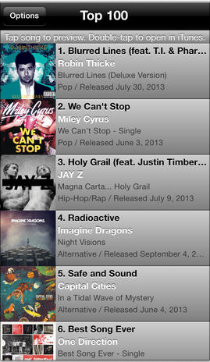
Top 100 Songs
Review
Crashing
Song 20 sec preview only

Slide 13
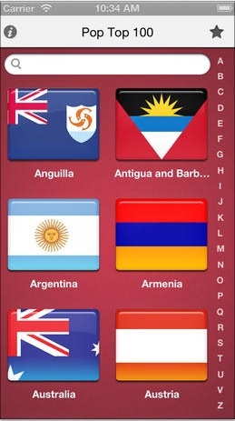
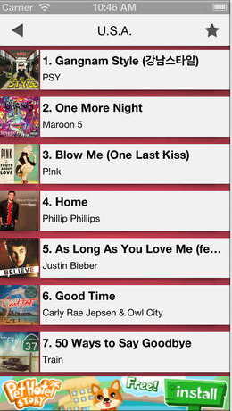
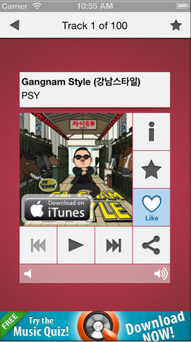
Pop Top 100
Country Chart Track
Review
Updated every hour
Bios, pics of artists ...
Airplay

Slide 14
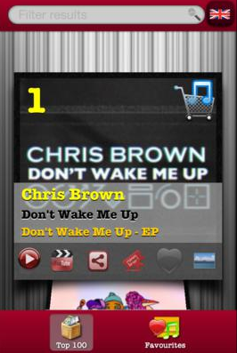
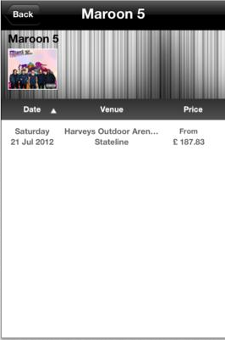
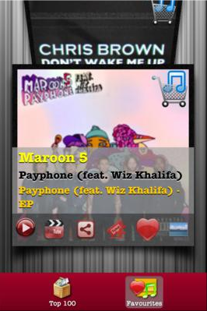
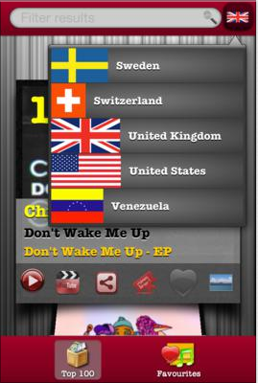
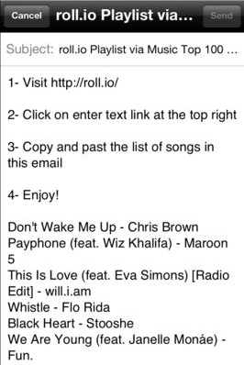
Music Top 100 Charts
Country
roll.io
Top 100
Favourites
Tickets
Review
Simple Interface
Buy tickets to concerts etc.
Export playlist to roll.io

Slide 15
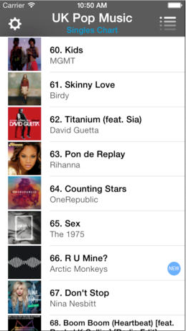
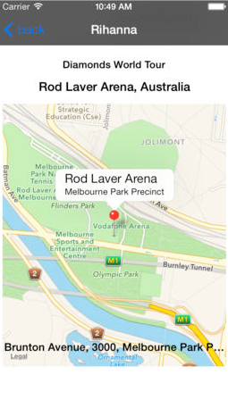
Chart Music
Chart Map of concert/tour
Review
Map and location of concert tour

Slide 16
Findings
Sample the song
Option to LISTEN or WATCH the vid.
Genres available
View songs that have moved up/down
Display when new song appears on chart
View top 100 from previous years
Allow sharing of songs via whatever
Display similar artists/filter
Offline playback support
Have a “My favourites” for reference/download etc.
Update chart every hour
Allow to buy/download from iTunes
Buy tickets to concert etc.
Export playlist to roll.io
Bios, pics, slideshow w/e
Chart rankings:
http://www.billboard.com/charts/hot-100
https://www.apple.com/ie/itunes/charts/songs/
http://www.last.fm/charts
http://www.7digital.com/chart/track7
App Icons, bgs, logos etc:
http://www.graphicsfuel.com/
http://www.yellowicon.com/
Bios, pics etc:
http://www.last.fm/
http://www.7digital.com/
Extra:
http://roll.io/#tmqf5q!0

Slide 17
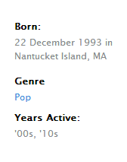
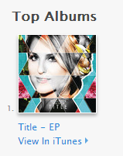

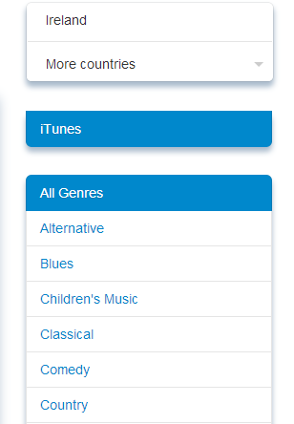
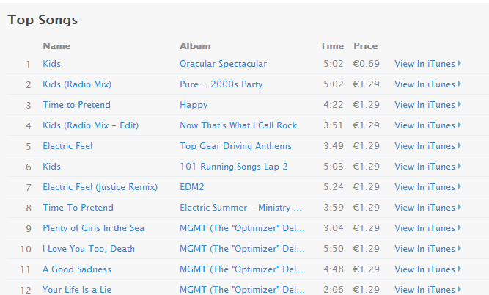

Slide 18
smthng
Text style constants: http://goo.gl/nJje5z
Designing for iOs: http://goo.gl/Agu2XW
Unity Andr: http://goo.gl/pXGkmd
First App/setup: http://goo.gl/uqvcLq

Slide 19
Top Music Charts - Pop
All about that bass
Bang bang
Ugly heart
Thinking out loud
Glow
Superheros
I’m not the only one
Stolen Dance
Ghost
Don’t
- Meghan Trainor
- Jessie J
- GRL
- Ed Sheeran
- Ella Henderson
- The Script
- Sam Smith
- Milky Chance
- Ella Henderson
- Ed Sheeran

Slide 20
Top Music Charts - Soundtrack
Let it Go
I see fire
Do you want to build a snowman?
A thousand years
Let it go
Yellow flicker beat
And I am telling you I’m not going
Love is an open door
Anyone who had a heart
Ordinary love
Idina Menzel
Ed Sheeran
Kristen Bell
Christina Perri
Idina Menzel
Lorde
Jennifer Hudson
Kristen Bell
Sheridan Smith
U2

Slide 21
Top Music Charts -World
Gaza
Hoppipolla
The town I loved so well
Steal away
Wonderful world
Willie McBride
Morning, Morning
Scorn not his simplicity
The parting glass
Time gentlemen time
James Mulvaney
Sigur Ros
Phil Coulter
Phil Coulter
Israel Kamakawiwo’ole
The Fureys
Corner Boy
Phil Coulter
Liam Clancy
Liam Clancy

Slide 22
Top Music Charts -Holiday
Winter Song
All I want for christmas is you
Santa Claus is comin’ to town
Mistletoe
Winter Song
When a child is born
Grandma got run over by a reindeer
One more sleep
O holy night
Last christmas
Sara Bareilles
Maria Carey
Bruce Springsteen
Justin Bieber
Twitterxmassingle
Sinead O’ Conner
Dr. Elmo
Leona Lewis
Glee cast
Wham!

Slide 23
Top Music Charts - Dance
Prayer in C
Blame
Changing
Lovers on the sun
Sunlight
Jubel
One day
Waves
The days
Summer
Robin Schulz
John Newman
Paloma Faith
Sam Martin
Years and Years
Klingande
Bakermat
Mr. Probz
Avicii
Calvin Harris

